Slide 1




Metallurgical Test Comparison of Aerospace Material using Additive Manufacturing Technologies vs. Wrought Technologies
Brittany Nez
Key Acknowledgements:
John Parsey
Keng Hsu
Donald Godfrey

Slide 2
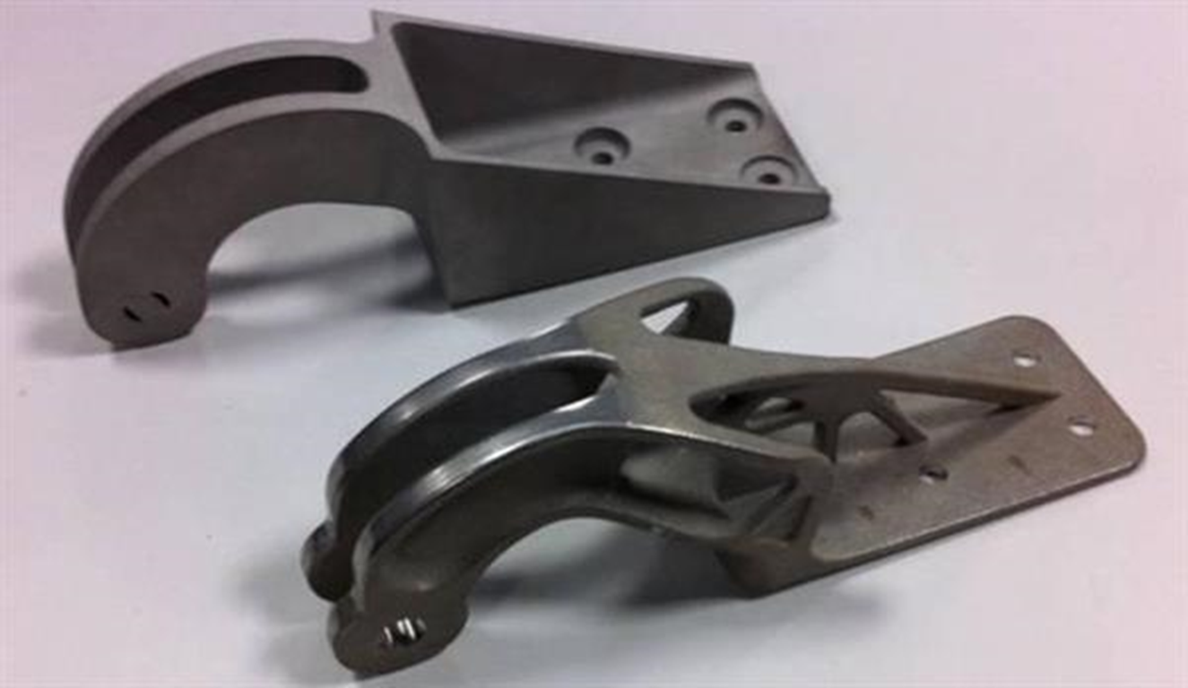
Benefits of Additive Manufacturing
Ability to create complex geometries
Weight reduction
Cost effective in low volume production
Can eliminate warehousing of spare parts/ maintaining manufacturing tools
Figure 1: Casted engine mount (upper left) and additive manufactured engine mount (lower right)
Notes:
-Change pic to forged comparison

Slide 3
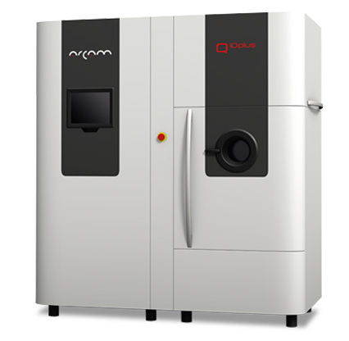
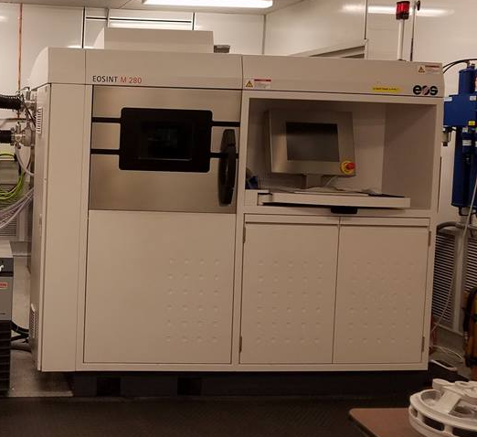
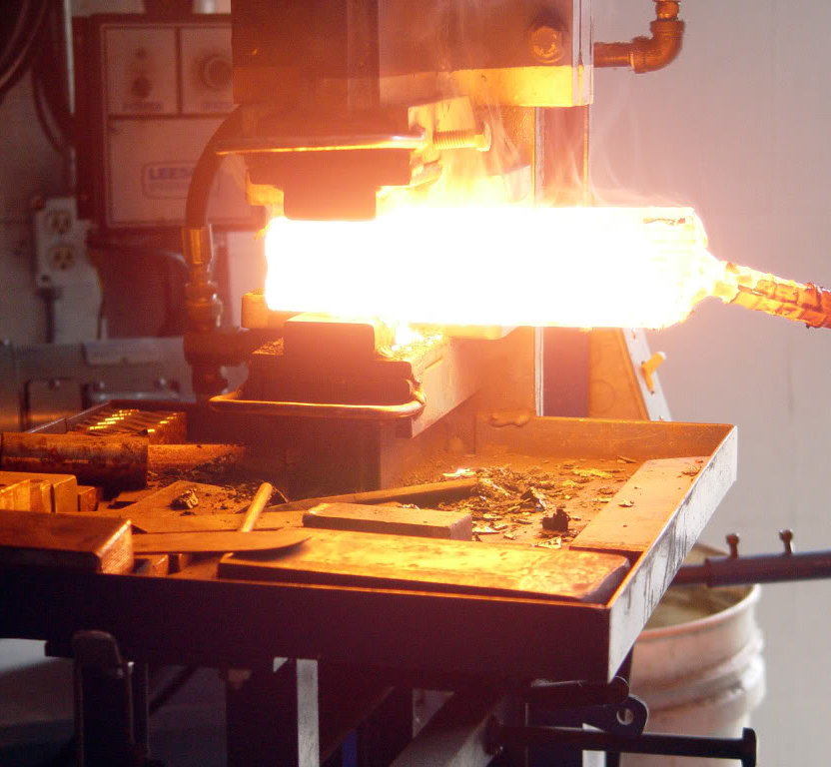
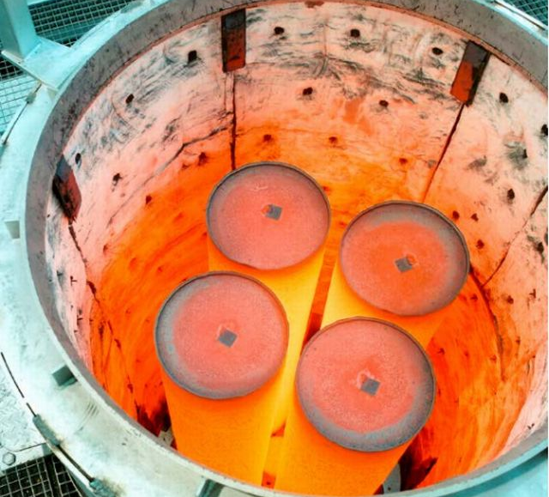
Experiment Specifics: Manufacturing Processes
Powder Bed Fusion (PBF)
  Electron Beam Melting (EBM)
    Praxair Powder
    Arcam Powder
  Direct Metal Laser Sintering (DMLS)
    Praxair Powder
Conventional Manufacturing
  Forging
Heat Treatment Processes
  Annealing
  Hot Isostatic Pressing (HIP)
Figure 2: Arcam Q10plus EBM Metal EBM Printer (upper left), EOSINT M 28 Metal DMLS Printer (upper right), forging process (lower left), and a hot isostatic press compression chamber (lower right)

Slide 4
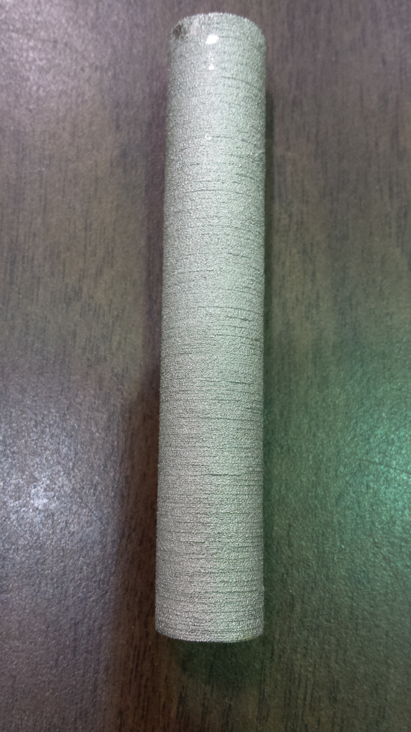
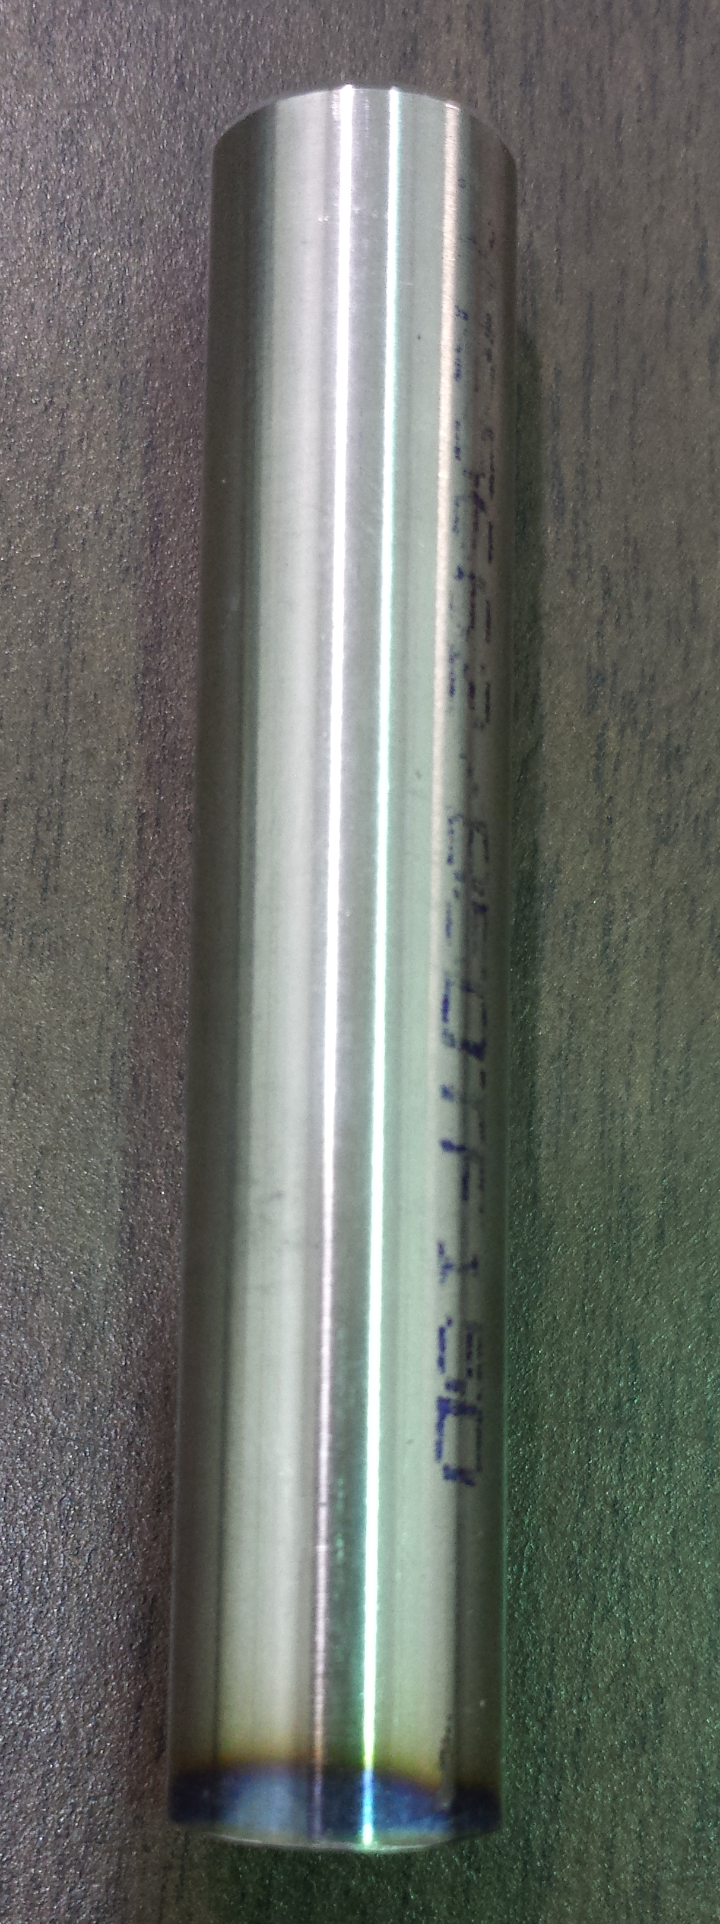
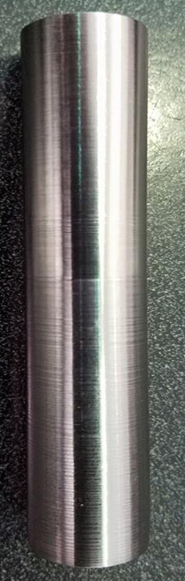
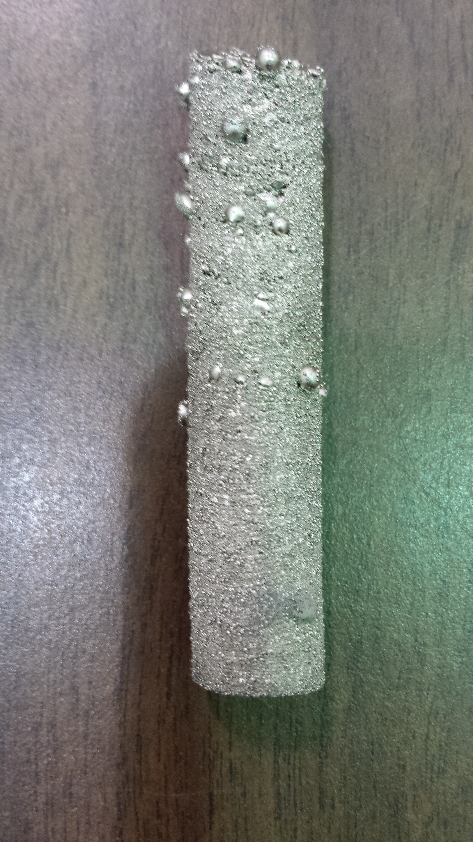
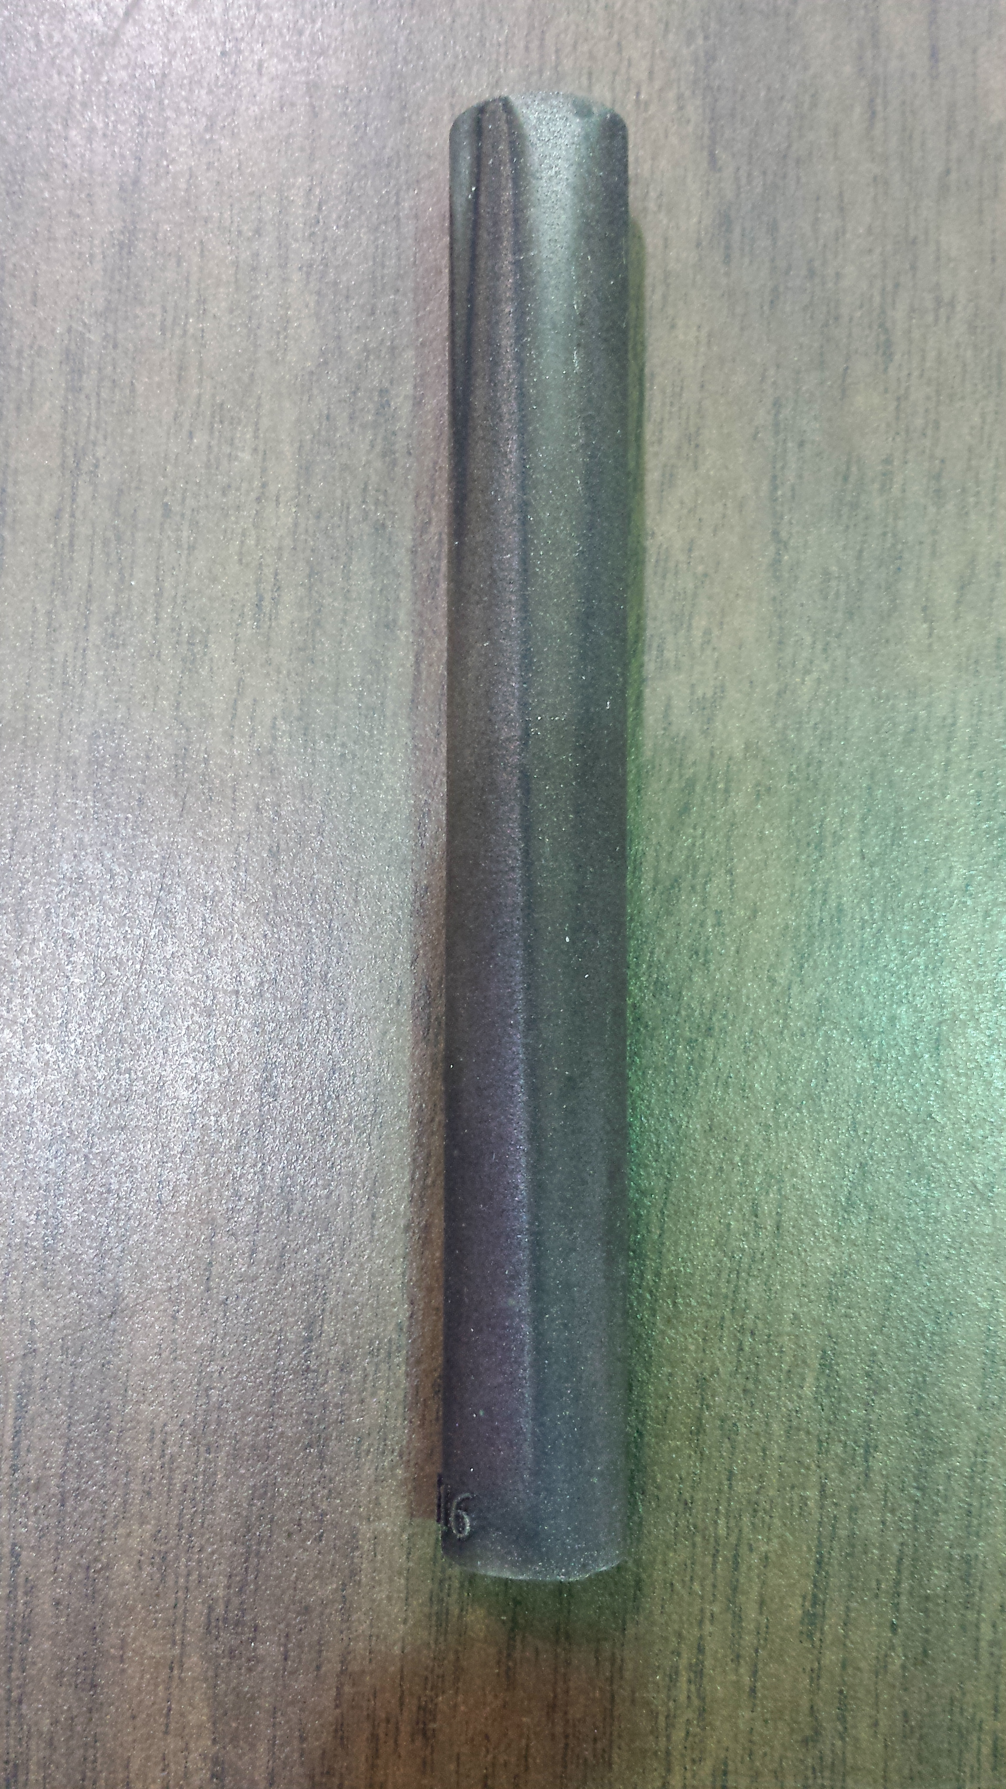
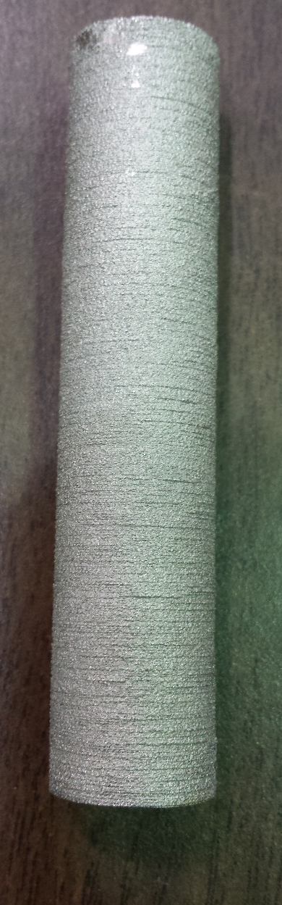
Experiment Specifics: Samples
All samples were printed, or provided by, Honeywell Aerospace, Phoenix
Samples were categorized based on four factors:
  Manufacturing Process
  Material
  Powder Source
  Bar Length
10mm
10mm
10mm
10mm
10mm
Figure 3: Sample bars provided by Honeywell Aerospace. (From Left to Right) EBM Praxair Inconel 718, EBM Arcam Inconel 718, Wrought Inconel 718, EBM HIP Arcam Inconel 718, DMLS Praxair Inconel 738

Slide 5
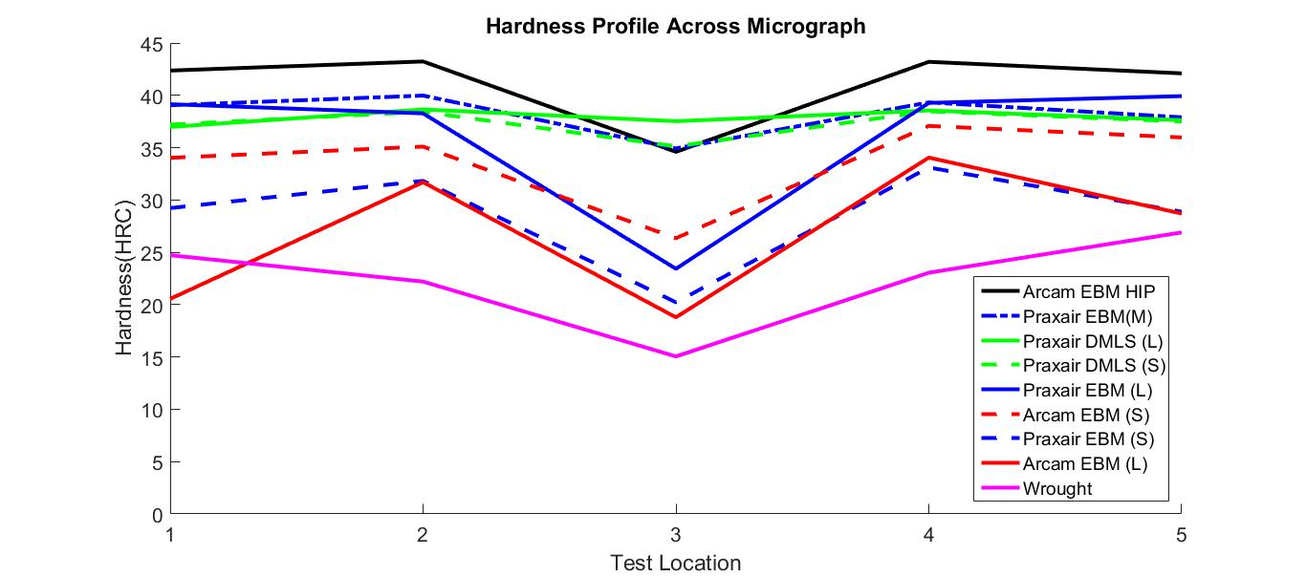
Results: Hardness Testing
Hardest Material: Arcam EBM HIP Inconel 718 at 41.2 HRC (avg)
Softest Material: Wrought Inconel 718 at 22.4 HRC (avg)
Softer center due to annealing effects
Interesting observation: DMLS bars maintained relatively consistent hardness across sample
Figure 4: Hardness profile across the hardness sample

Slide 6
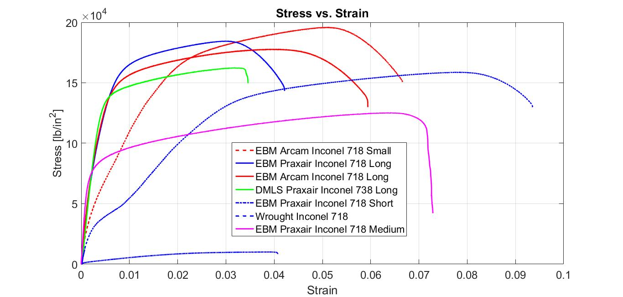
Results: Tensile Testing- Modulus and Yield
Highest Young’s Modulus: Wrought Inconel 718 (5.10e7 lb/ft^2)
Lowest Young’s Modulus: EBM Praxair Inconel 718 (1.60e7 lb/ft^2)
Highest Ultimate Strength: EBM Arcam Inconel 718 Small (195000 lb/ft^2)
Lowest Ultimate Strength: EBM Praxair Inconel 718 Medium (121000 lb/ft^2)
Highest Yield Strength: EBM Arcam Inconel 718 Long (133000 lb/ft^2)
Lowest Yield Strength: EBM Praxair Inconel 718 Small (40300 lb/ft^2)
Figure 5: Stress-Strain curve from tensile test data

Slide 7
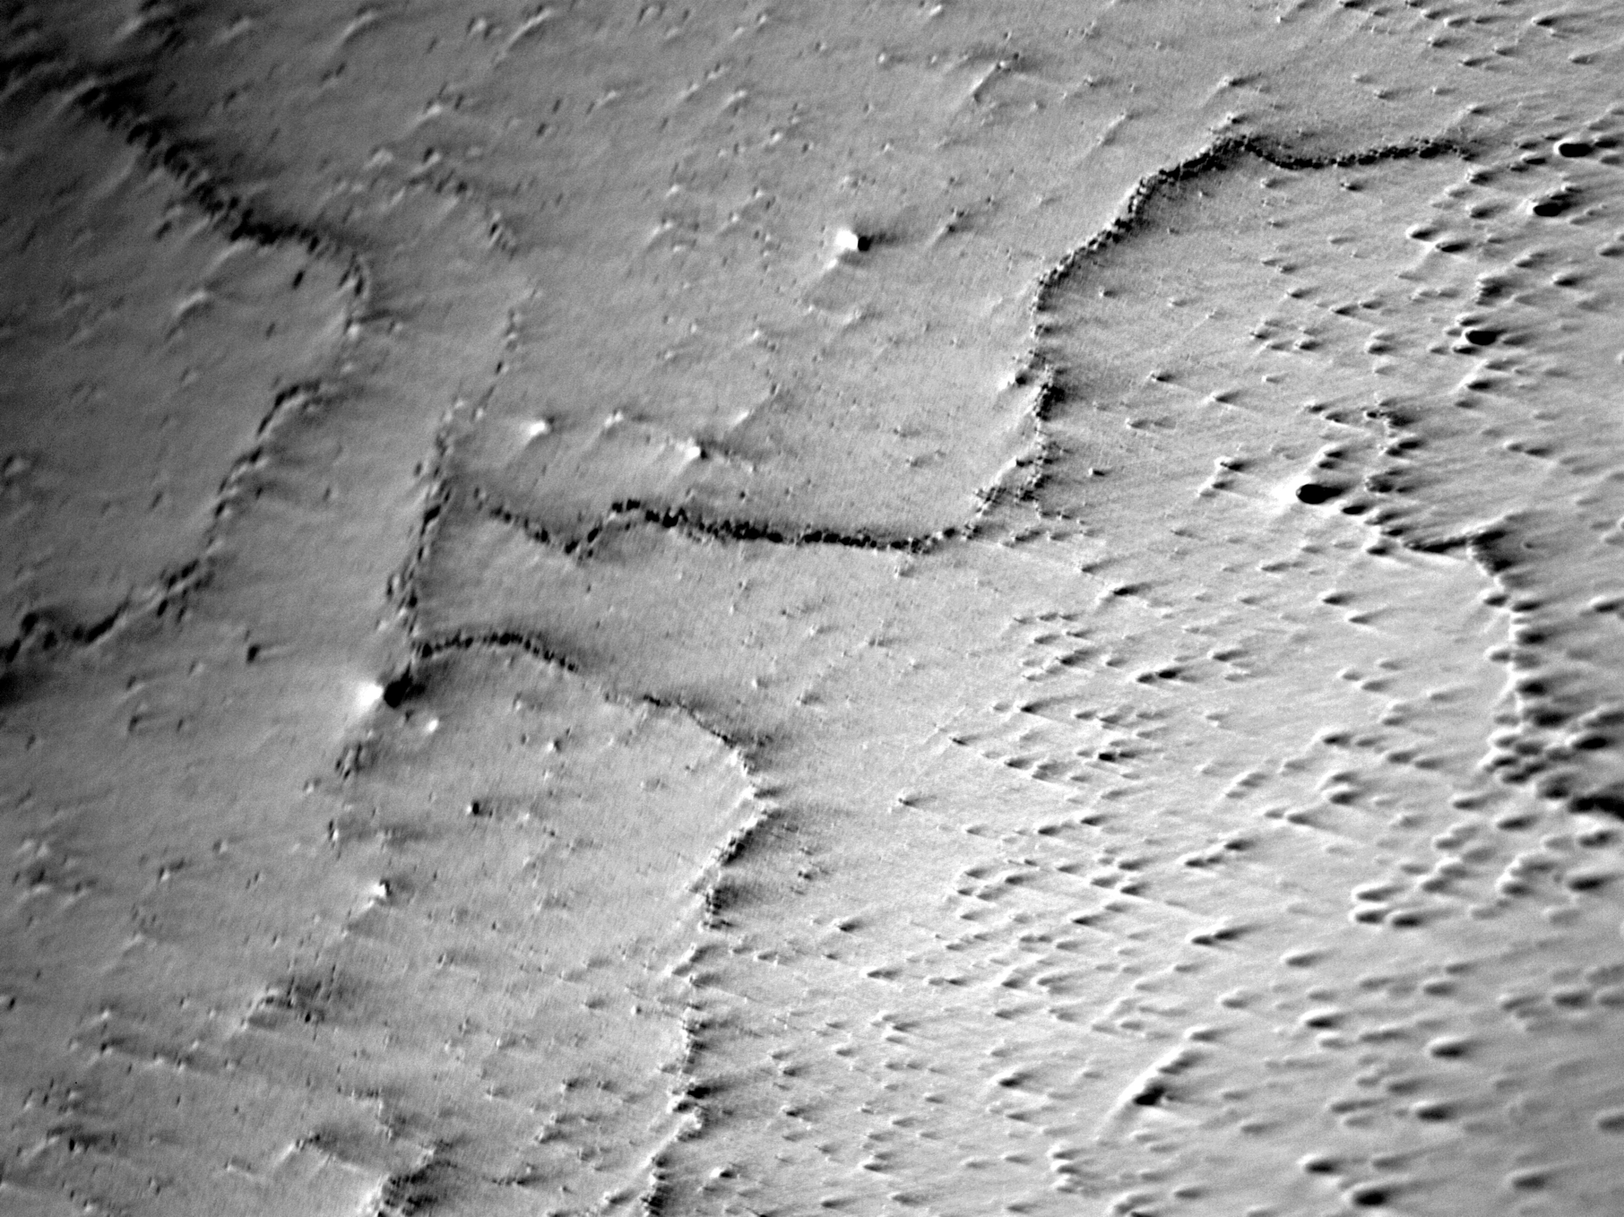
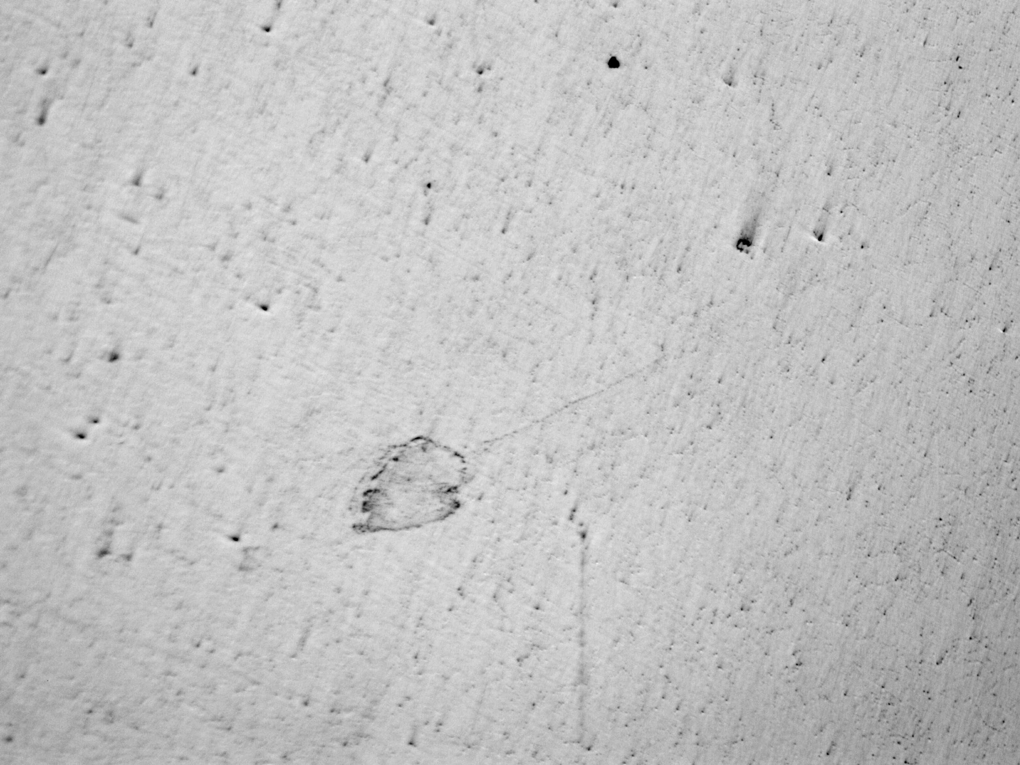
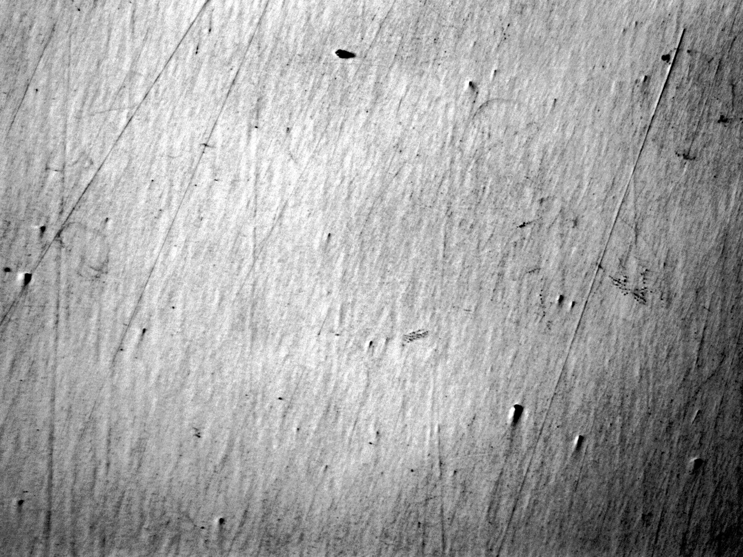
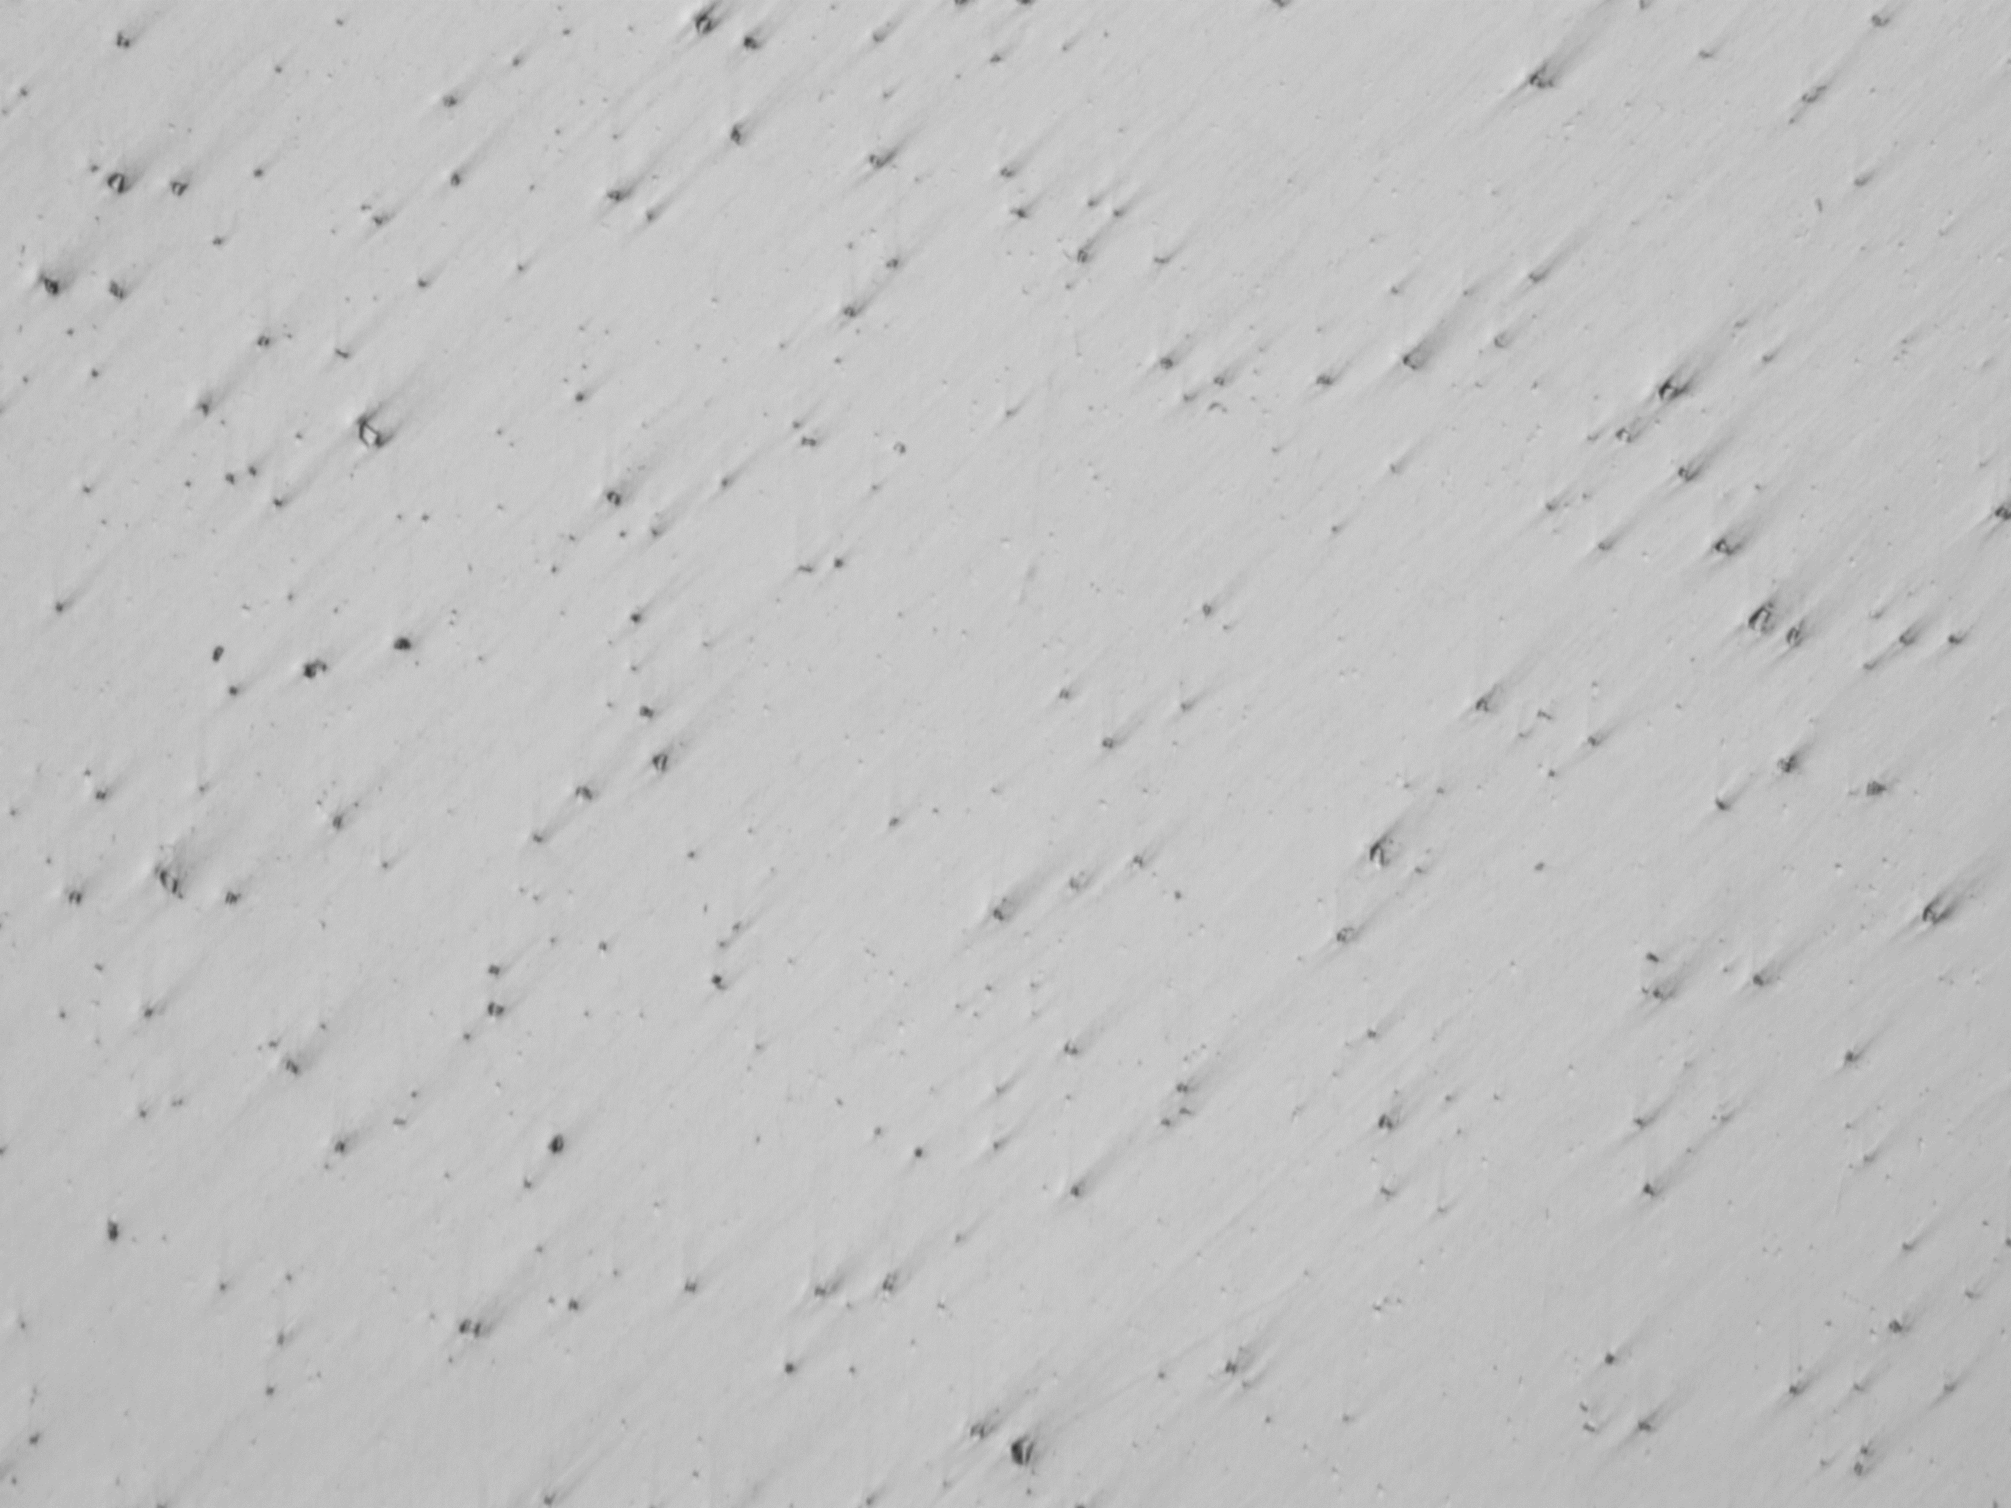
Results: Grain Structure
1mm
1mm
EBM rods showed large grain structure, visible after etching (Figure 28-a)
EBM HIP rod grain structure was significantly finer than regular EBM bars (Figure 28-b)
DMLS and wrought grain structure could not be developed (Figure 28-c and d)
Use of a different etchant may allow developing of the grain boundaries
(a)
(b)
1mm
1mm
(c)
(d)
Figure 6: Grain Boundary structure of (a) EBM Praxair Inconel 718 Long, (b) EBM HIP Arcam Inconel 718, (c) DMLS Praxair Inconel 738 Long, and (d) Wrought Inconel 718 samples

Slide 8
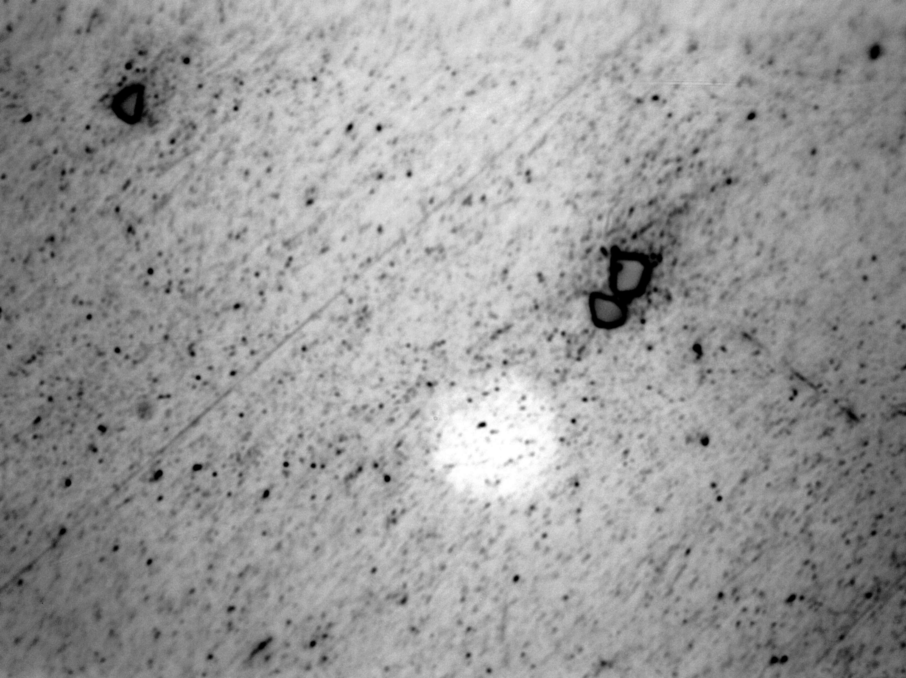
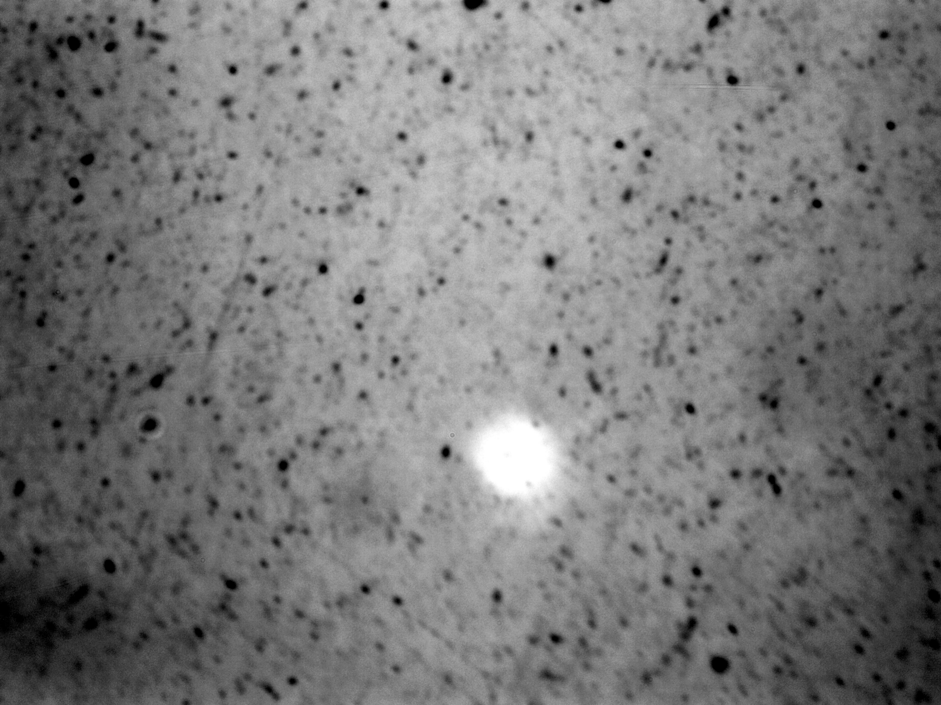
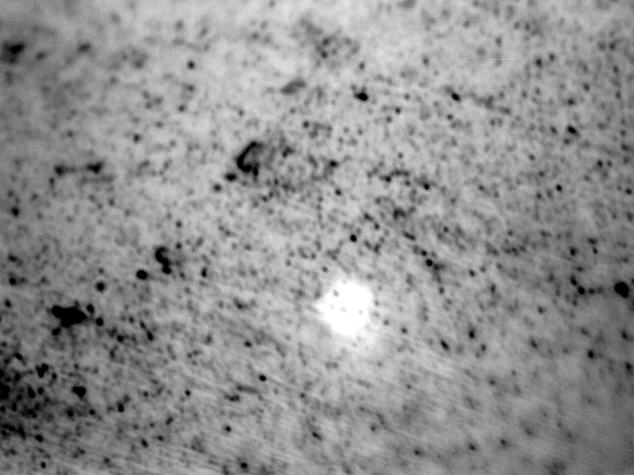
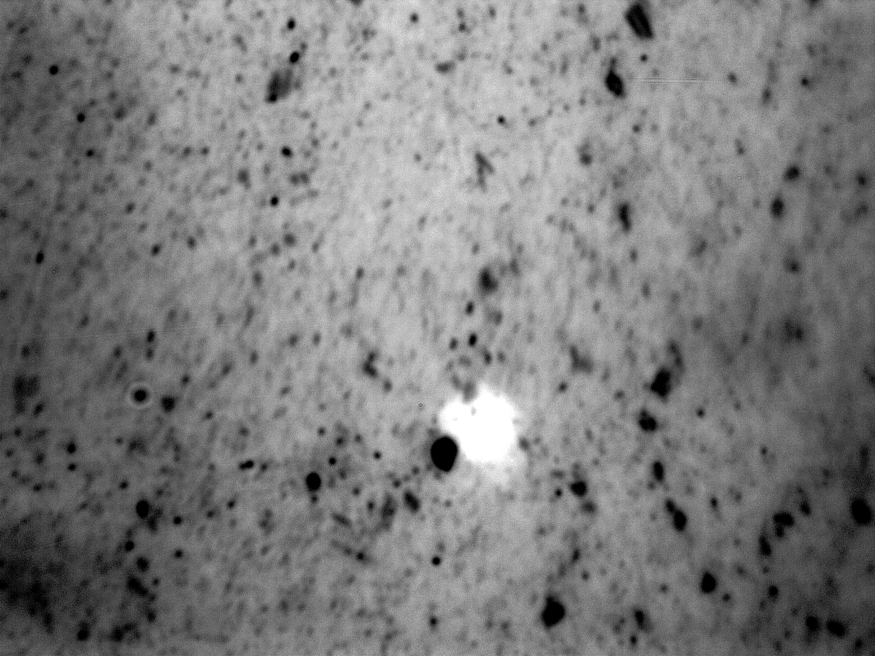
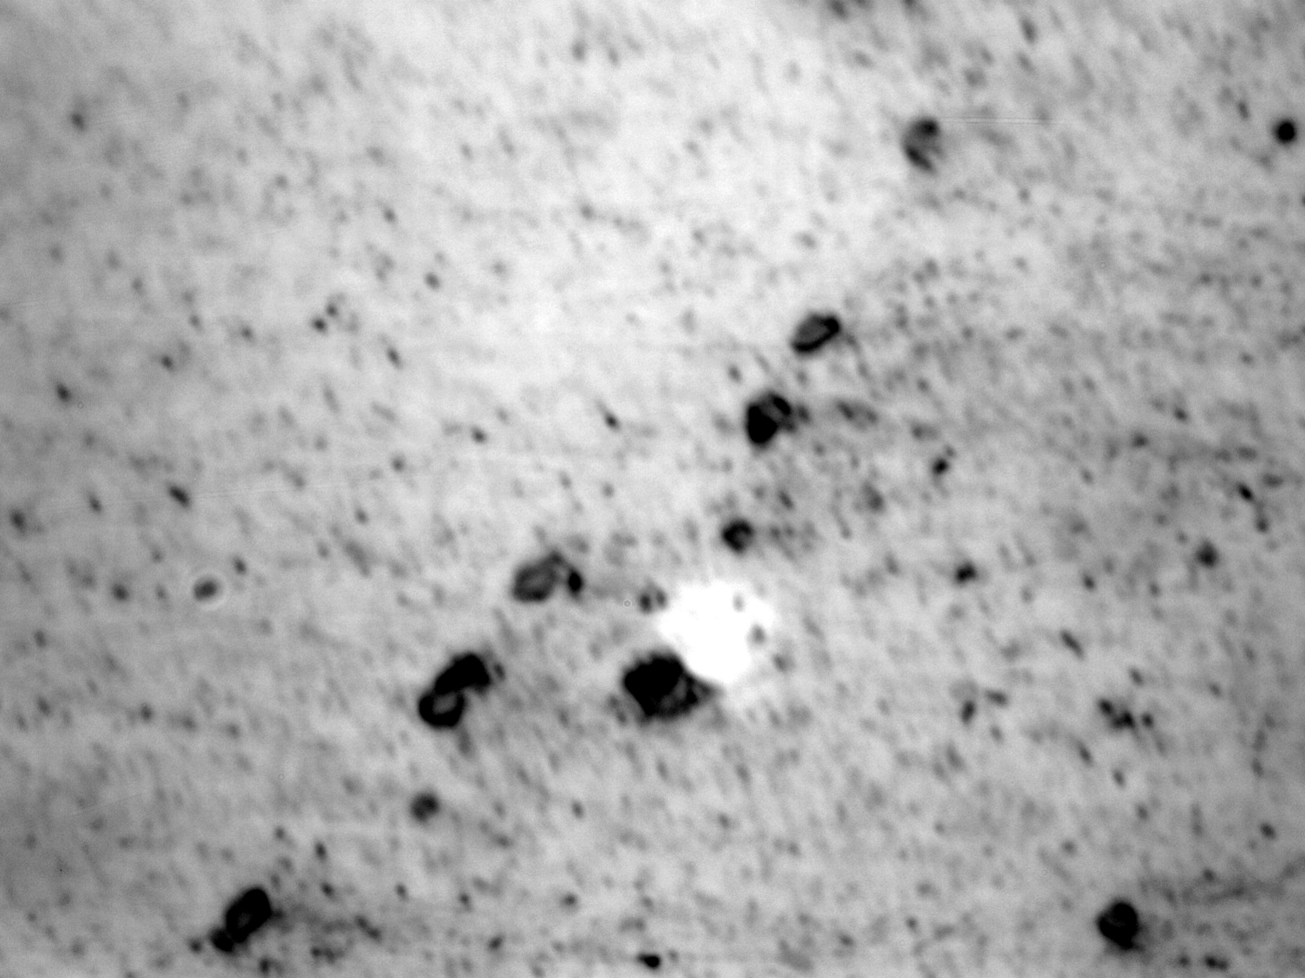
Results: Porosity
Figure 29 shows grain boundary structures, precipitation, and porosity, 2500x magnification
EBM Praxair Inconel 718, EBM Arcam Inconel 718 and DMLS Praxair Inconel 738 samples have many small voids.
EBM HIP Arcam Inconel 718 sample has more uniform porosity
Wrought Inconel 718 sample shows porosity similar to that of the regular EBM and DMLS samples.
(a)
(b)
(c)
(d)
(e)
Figure 7: Porosity, precipitation, and grain boundary structures for (a) Wrought Inconel 718, (b) DMLS Praxair Inconel 738, (c) EBM Arcam Inconel 718, (d) EBM HIP Arcam Inconel 718, and (e) EBM Praxair Inconel 718 samples

Slide 9
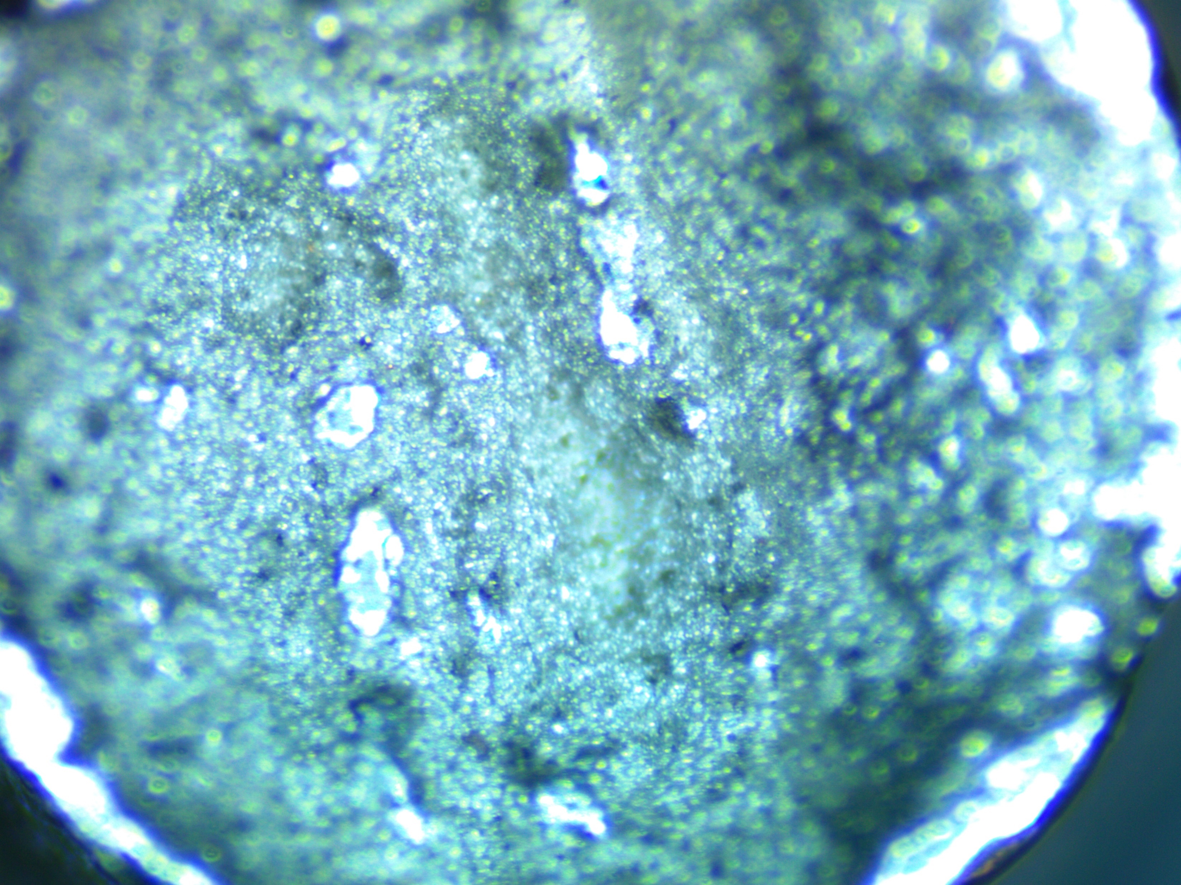
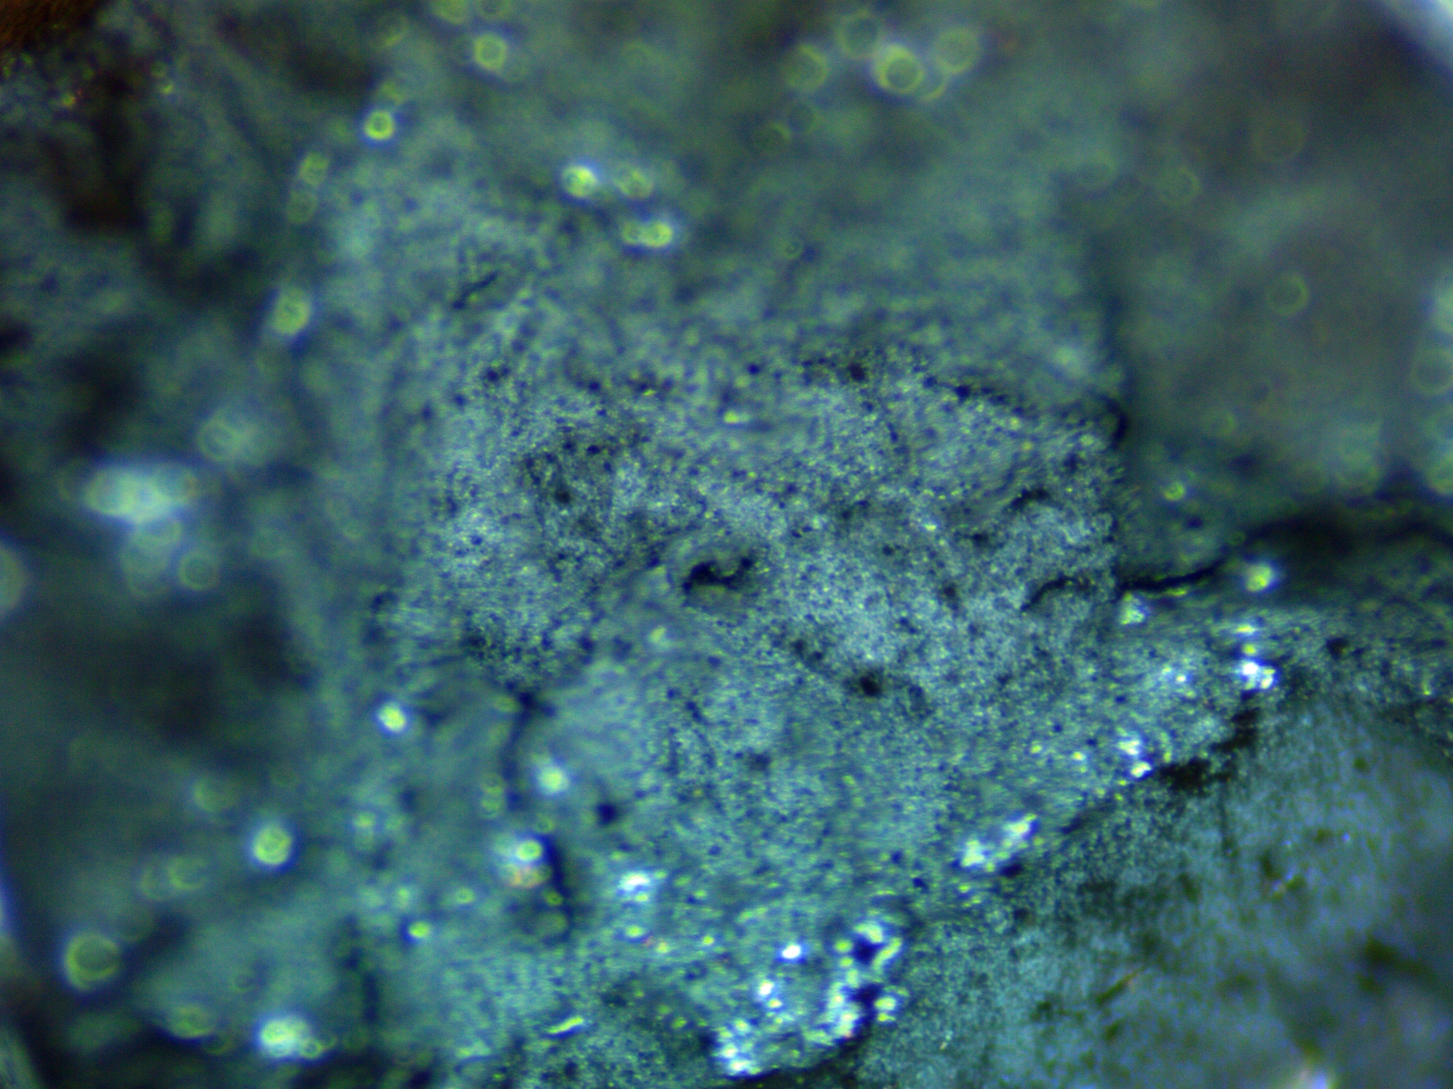
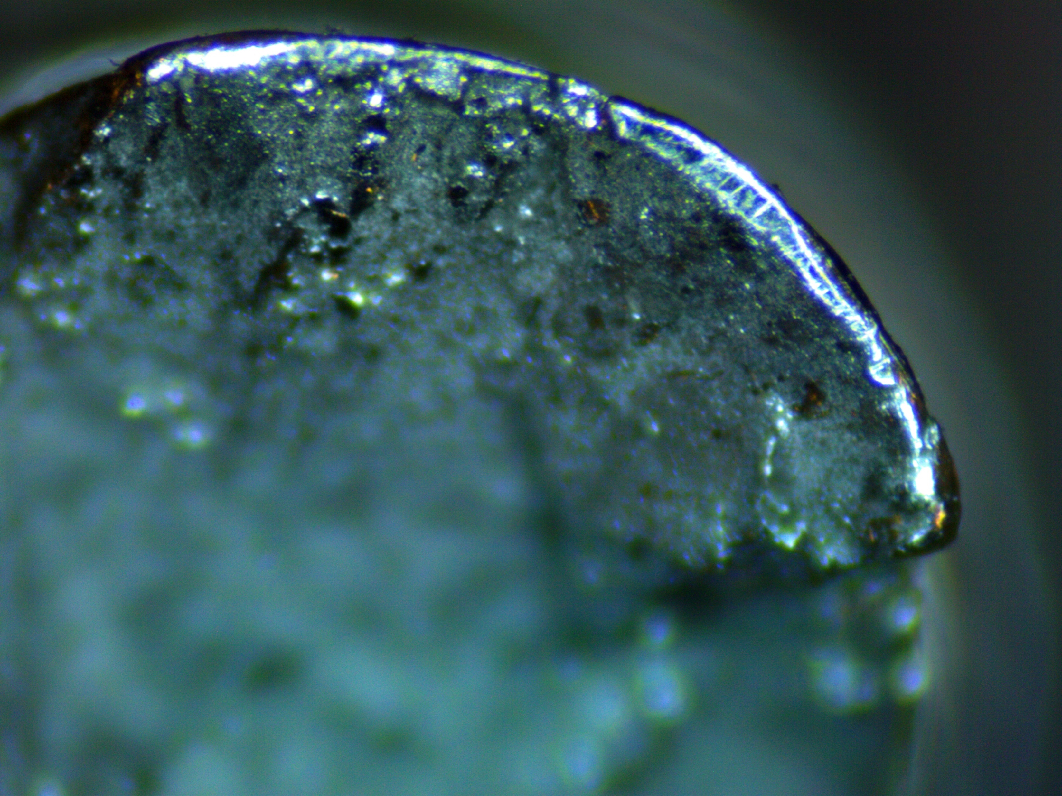
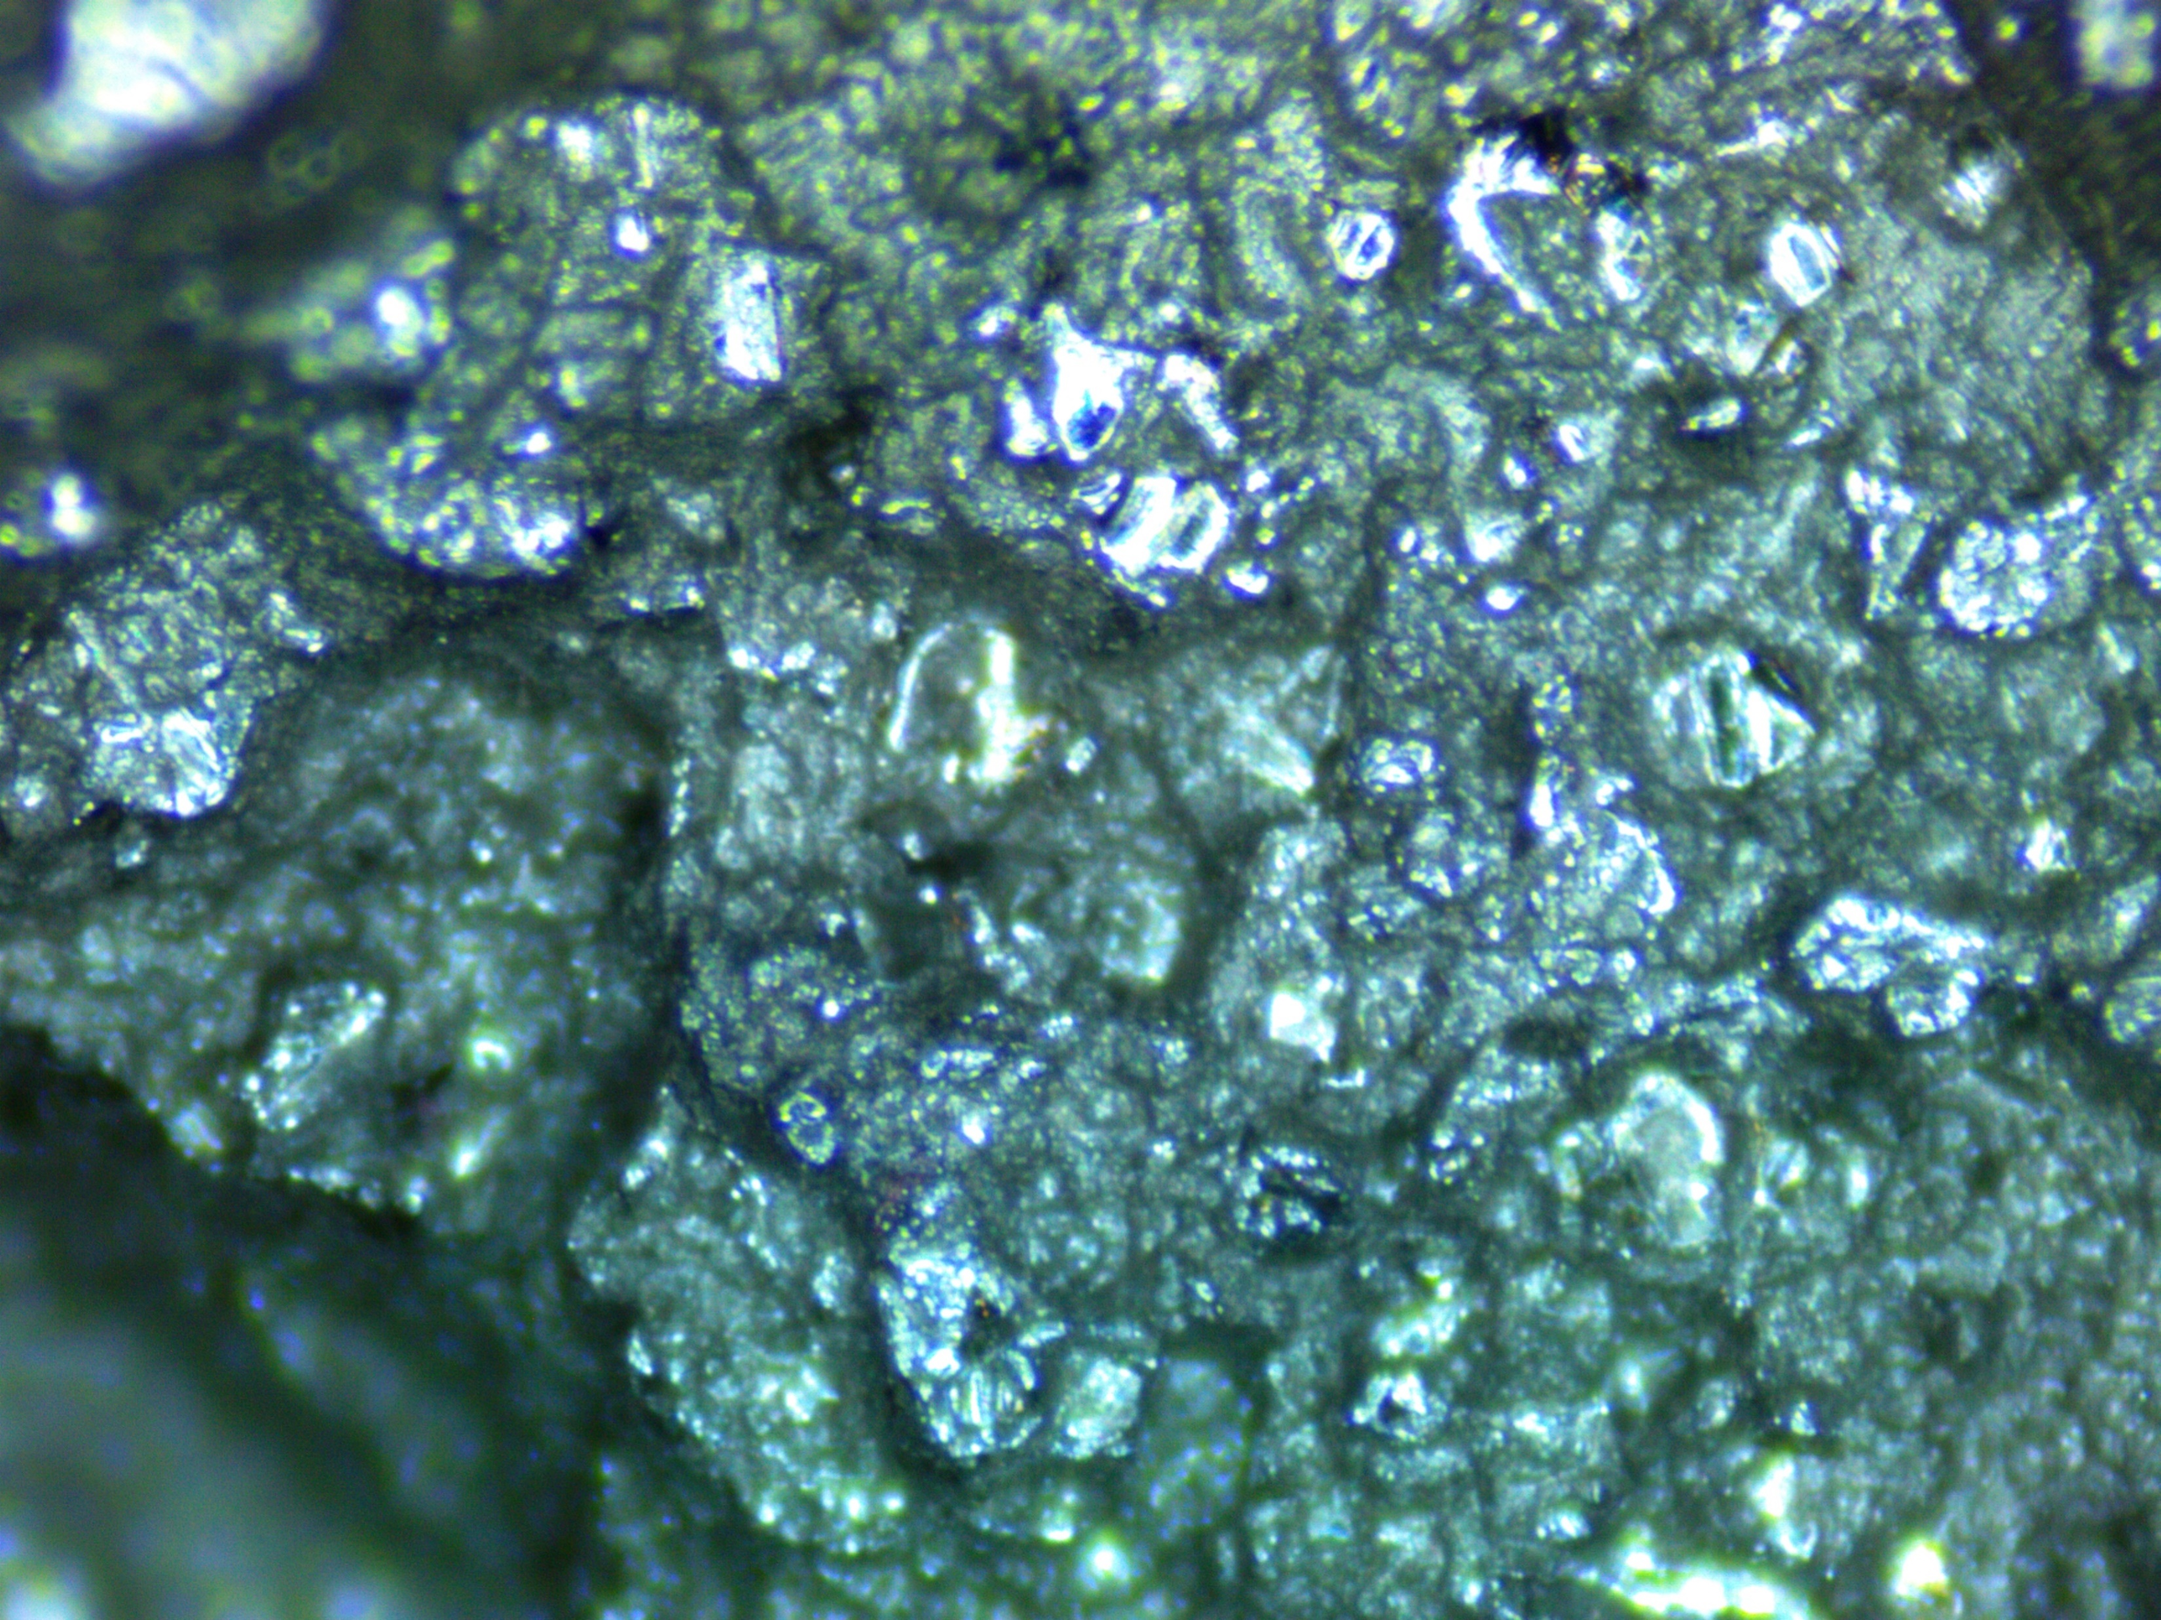

Results: Fractology
Wrought rods were found to have ductile fracture
  cup-cone structure
Rods with mixed ductile/brittle behavior exhibited characteristics of both fracture types
DMLS rods and short EBM Praxair Inconel 718 rods showed brittle fracture
  DMLS Praxair Inconel 738 rods showed pre-fracture cracking
(a)
(b)
(c)
(d)
(e)
Figure 8: (a) Ductile wrought Inconel 718, (b) ductile center of EBM Arcam Inconel 718, (c) brittle perimeter of EBM Arcam Inconel 718, (d) brittle DMLS Praxair Inconel 738, (e) pre-fracture cracking of DMLS Praxair Inconel 738

Slide 10
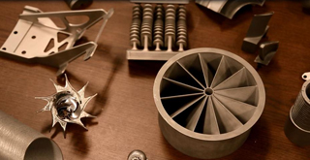
Conclusion
Porosity and precipitation in non-HIP AM material nearly identical to wrought sample
All AM samples show greater hardness than wrought sample
Wrought sample found to be most ductile material
Grain structure comparison inconclusive due to insufficient etching of wrought samples
AM sample tests show they would be able to maintain, and perhaps exceed, expectations of the aircraft industry when compared to the wrought results
Figure 9: AM aerospace parts created by Honeywell Aerospace, Phoenix courtesy of Donald Godfrey

Slide 11
Acknowledgements
Mentor: John Parsey
Secondary Mentors:
Keng Hsu
Donald Godfrey
ASU/NASA Space Grant
Honeywell Aerospace – Phoenix: Additive Manufacturing Team
Machining and Manufacturing at ASU Polytechnic:
Rhett Sweeney
Scott Almen
John Dolan

